Slide 1
Cyclistic Bike-Share
Marketing Analysis
Presentor: Malcomb C. Brown
Date: 12-07-2022

Slide 2
Outline
Executive Summary
Introduction
Methodology
Tools
Techniques
Results
Visualizations
Dashboard
Discussion
Trends
Insights
Conclusion
Recommendations
Appendix

Slide 3
Executive Summary
Convert casual riders into annual members
Identify differences between customer types
Internal trip data from Nov 2021 - Oct 2022
Bike-share program:
Has 5800+ bikes and 600+ docking stations
8% of riders use assistive options
30% use Cyclistic to commute to work
Tools used:
Notepad++
Excel
Python
Power BI
Marketing strategy recommendations
Notes:
Design a marketing campaign targeted at converting casual riders into annual members.
Uncover trends and insights in how annual members and casual riders us Cyclistic differently.
Differences are based on number of rides per day and per month but also average ride length, in minutes, by day and month.
This was also compared by type of bike.

Slide 4
Introduction
Business Goal:
Design a marketing campaign that converts casual riders into annual members.
Business Task:
Identify the differences between how annual members and casual riders use our bikes
Overview:
Collected previous 12 months of Cyclistic trip data internally.
Dataset does not contain any personal identifying attributes.
Data represents unique ride events.
Used descriptive statistics, filtering, aggregation, and visualizations to uncover trends and insights.
Geographical data not used as part of this analysis.
Maintenance records removed before analysis.
Notes:
@ 940,000 records missing geographical data
Records containing negative, or 0, values for ‘ride_lenght’ are considered maintenance records.
No way of tracking whether a customer uses our service more than once a day.

Slide 5





Methodology
Source: Cyclistic internal trip data from Nov. 2021 - Oct. 2022.
Pre inspection and preprocessing performed in Notepad++ & Excel:
Data Exploration
Analysis completed using Python in a Jupyter notebook:
ETL
Data Wrangling
Descriptive statistics
Data visualization
Dashboard designed with Microsoft Power BI.
Presentation created in Google Slides.
Notes:
Downloaded as 12 zip files.
Extracted csv files from each zip file.
Used to get a feel for the dataset, verify table structure, and perform basic descriptive statistics.
Pandas, OS, Matplotlib, and Seaborn were the libraries used

Slide 6
Analysis Results
Market Share
Customer type
Bike type
Daily Trends
Rides by day of the week
Avg. ride time
Monthly Trends
Rides by month of the year
Avg. ride time
Outliers
Which customers ride times affect the average?
What bikes are being used?
Notes:
Market Share:
Which customer type uses Cyclistic most? By what percent?
Same for bike type
Trends:
Daily
Rides per day
Avg. ride length
Monthly
Monthly rides
Avg.ride length
Outliers:
Do certain customers ride longer?
Which bikes are used?

Slide 7
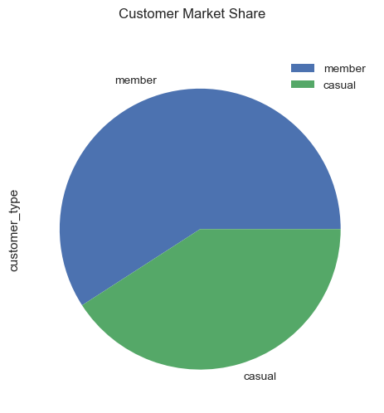
Customer Market Share
Annual members comprise 59.1% of riders
Annual members are more profitable
30% of riders use to commute to work
8% of riders use our assistive bike options*
59.1%
40.9%
Notes:
Out of 5,755,128 ride events
Member: 3402379
Casual: 2352749
Pricing plans:
Single-ride passes
Full-day passes
Annual memberships
Remember:
Casual riders are customers who purchase the single-ride or full-day passes.
There is no way to account for customers who use Cyclistic multiple times in a day.
While casual riders make up 40.9% of riders.
Assistive bike options are:
Reclining bikes
Hand tricycles
Cargo bikes
These make bike sharing more inclusive for people with disabilities.

Slide 8
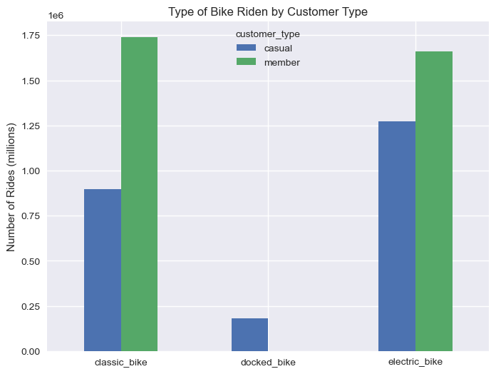
Bike Market Share
Only casual riders use ‘docked’ bikes
Casual riders use electric bikes more than 50% of the time
Casual riders use every bike type
Annual members use classic bikes most
Members use classic bikes twice as much as casual riders
Electric bikes are the most popular overall
1.74 M
1.66 M
1.27 M
897 K
182 K
Notes:
Out of 5,755,128 ride events
Classic_bike: 897,376 | 1,740,432
Docked_bike: 182,194 | 0
Electric_bike: 1,273,179 | 1,661,947
Remember:
Casual riders are customers who purchase the single-ride or full-day passes.
There is no way to account for customers who use Cyclistic multiple times in a day.
Annual members slightly prefer classic bikes to electric bikes.

Slide 9
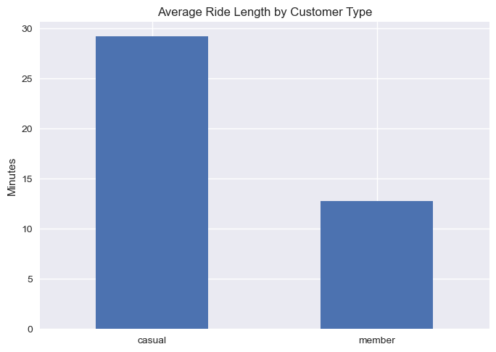
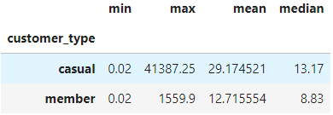
Customer Average Ride Length
Casual riders ride more than twice as long as members
Members average 12.72 mins per ride
Casual riders avg. 29.71 mins per ride
29.71
12.72
Notes:
Mean > Median = Right skewed data points.
Suggests outliers exist, on the high end.
For both casual riders and annual members, the max ride length indicates some customers keep the bikes longer than 24 hours.
Removed maintenance records contained negative entries, if positive, that exceed 24 hrs.

Slide 10
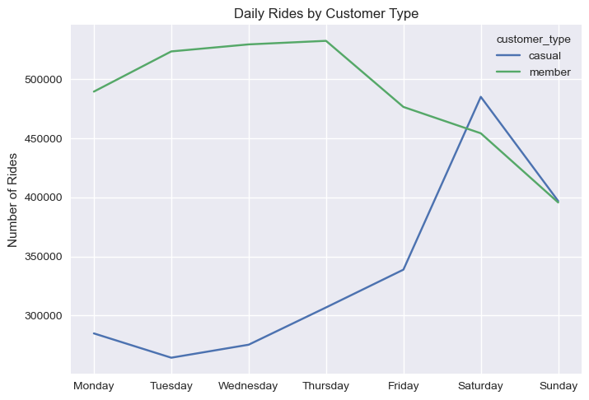
Daily Trends
Number of Rides
Saturday is the busiest day of the week
Members ride most on weekdays
Sun. is the only day members ride count less than 450,000
Casual riders ride mostly on weekends
Casual riders are highest demographic on Sat. and Sun.
Sat. and Sun. are the only days casual riders ride count exceeds 350,000
Notes:
What percent of members make up the 30% of users using Cyclistic to commute?
Can we survey customers to discover how and why they utilize our service?

Slide 11
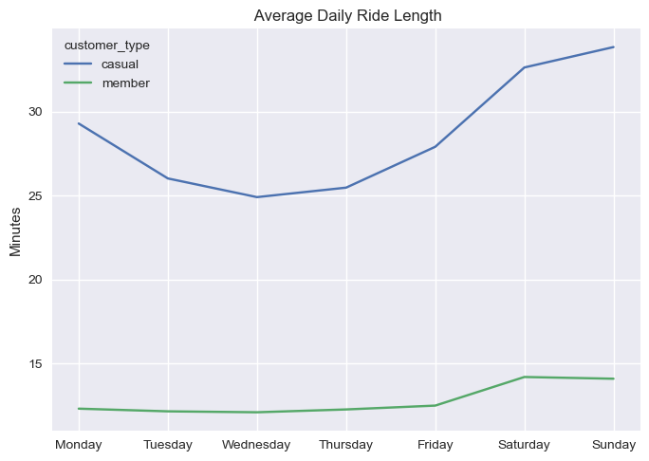
Daily Trends
Average Ride Time (minutes)
Members and casual riders ride longer on weekends
Casual riders ride longest on Sundays
Casual riders average less than 30 minutes ride time on weekdays
Members on average ride less than 13 minutes a day
Notes:
Are there events, festivals, or other reasons customers ride longer on the weekend?
Lower weekday avg. ride times could be the result of commuters while on the weekend is more for leisure riding.
Members ride longer when they ride less.
During weekdays, member’s ride count is at it highest while its average ride time is at its lowest.
This flips on the weekend
For casual riders, as expected, when there are more riders, ie weekend, the average ride times increase.

Slide 12
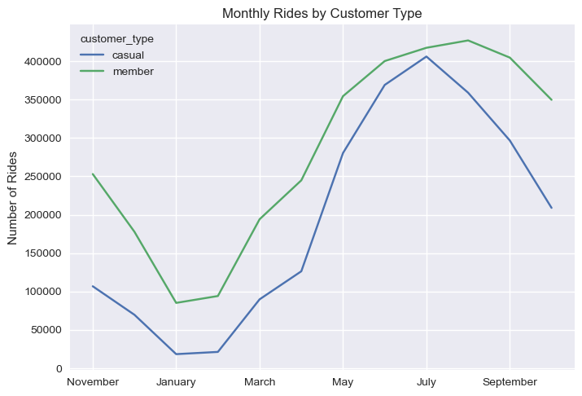
Monthly Trends
Number of Rides
Members ride more than casual riders
Summer is the busiest season
July is the busiest month
Winter is the slowest season
January is the slowest month
Rides increase significantly from April to May
June and July difference less than 50,000
Notes:
April to May increase experienced by both annual members and casual riders.
June - July difference between the number rides of our members and casual riders.

Slide 13
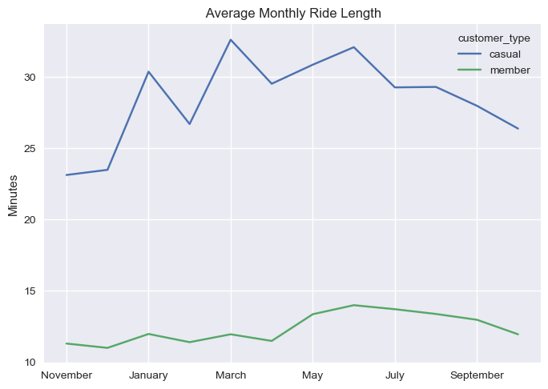
Monthly Trends
Average Ride Time (minutes)
Members avg. ride time is less during the winter
Casual riders avg. ride time decreases in the fall
Casual riders ride longer in Jan. and Mar. thru Jun.
Spring has the highest combined average ride lengths
Notes:
If audience has access to the dashboard highlight the drilldown by day.

Slide 14
Trends and Insights

Slide 15
Trends and Insights
Summer is the busiest season
Casual riders’ avg. ride length is more than double that of annual members
Casual riders ride more than members on the weekend
Annual Members ride more on weekdays
Only casual riders use the ‘docked’ bike option
Notes:
Limitations:
Geographic data not used in analysis, missing ~940,000 records
Maintenance records were removed
Some contain negative records that may have been entered inaccurately
Records where Cyclistic staff remove a bike to check quality
Percentage of each type of rider who:
Commutes to work, by type
Use for events
Have disabilities
Mention the outliers as part of the appendix
Pertain solely to casual riders
Pertain only to docked bikes

Slide 16
Recommendations

Slide 17
Recommendations
Conduct a survey of casual riders.
Why do they choose Cyclistic?
How do they utilize our service?
Why do customers choose a bike type?
Target the ‘docked’ bike riders.
Members do not use ‘docked’ bikes.
Represents 3% of all rides.
8% of customers choose assistive bike options.
Partnerships.
Local businesses.
Events.
Festivals.
Notes:
Restate limitations, if needed.
Would like 4-6 weeks for further analysis.
Survey?
Geographical data?
Verify maintenance records?

Slide 18
Survey
Conduct a survey of our casual riders to gather more data to design the marketing strategy around. We can gain an understanding of WHY casual riders choose a specific payment option and type of bike.
While the survey is taking place, further data cleaning and verification of geographical data can be done and added into the analysis. Data architects can explain how data is entered in the system.
Notes:
As we’re coming up on winter, that allows time to conduct a survey to acquire more data for analysis.
Ex. Geographic data, and maintenance records
We can use the survey data to find where customers pickup and drop off our bikes.
Do they use them to go to festivals or events?

Slide 19
Docked Bike Type
Design a campaign focused on converting the ‘docked’ bike riders into annual member. 3% of all rides occur on these bikes and only casual riders use them. 8% of customers use our assistive bike option, providing a service to those with a disability.
Highlight the cost benefits of becoming an annual member as these riders, on average, ride longer. For disabled riders, we should offer a discount or additional service.
Notes:
A survey may help.
Benefits for disabled riders can improve company image and give us some publicity and FREE advertising.
See partnerships.

Slide 20
Partnerships
Establish partnerships with local businesses and organizations. Casual riders use Cyclistic mainly for leisure. Target the benefit of annual memberships for riders who also do business with partners. This is to include our local sports franchises, museums, and zoo.
Work with a nonprofit focused on assisting disabled citizens to provide services for them.
Notes:
Geographic data.
Survey
Benefits of working with the non profit:
Publicity/ Free Advertising
Possibly able to structure the deal to be tax beneficial

Slide 21
Appendix

Slide 22
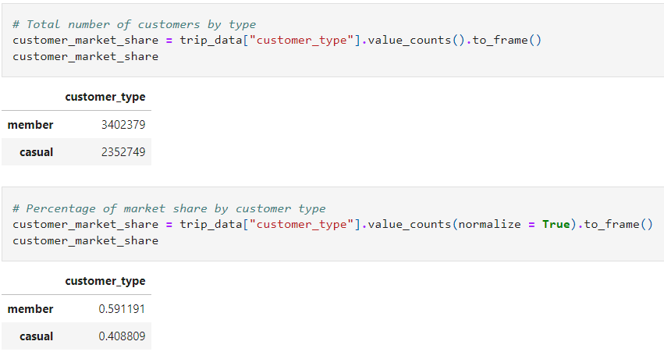
Rides by Customer Type
Notes:
Code used to:
Calculate the number rides per customer and bike type.
Plot the resulting bar graph.

Slide 23
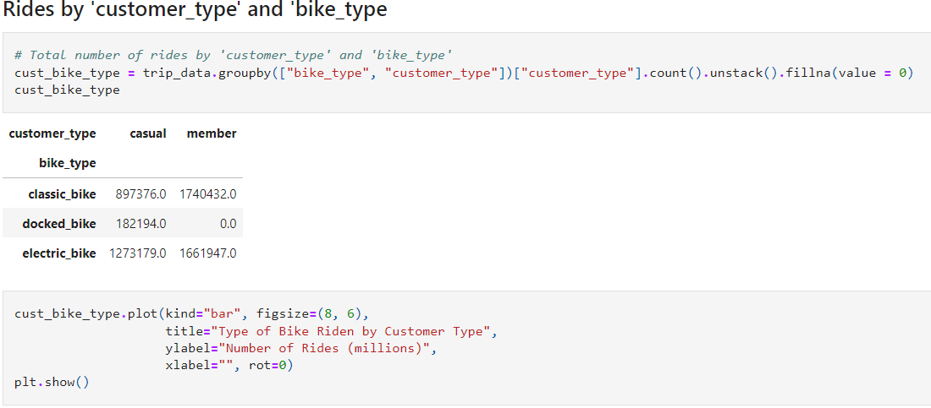
Rides by Customer & Bike Type
Notes:
Code used to:
Calculate the number rides per customer and bike type.
Plot the resulting bar graph.

Slide 24
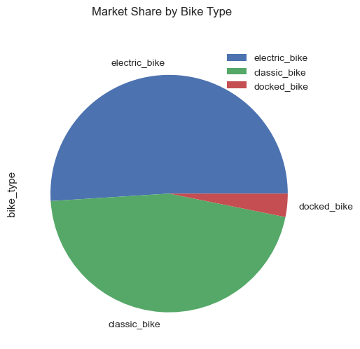
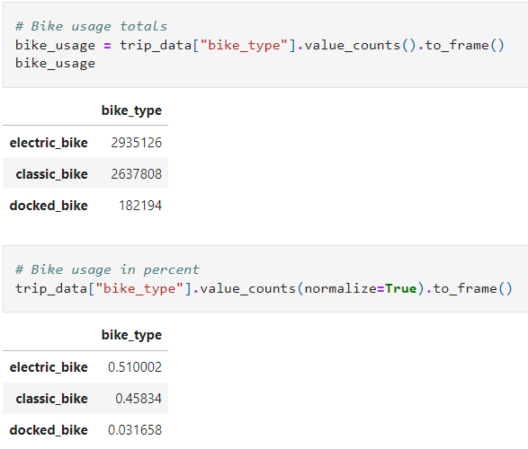
Rides by Bike Type
Notes:
Code used to calculate the number rides by each bike type.

Slide 25
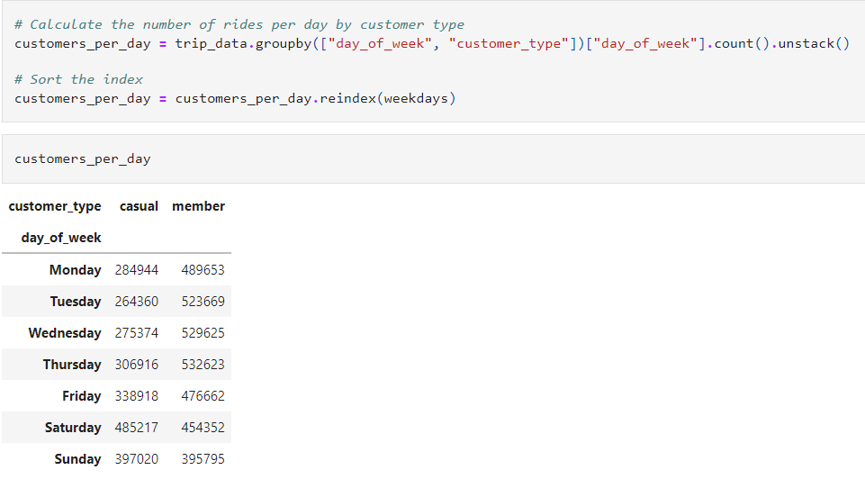
Rides per day by Customer Type
Notes:
Code use to calculate the number of rides per day occurred by customer type.

Slide 26
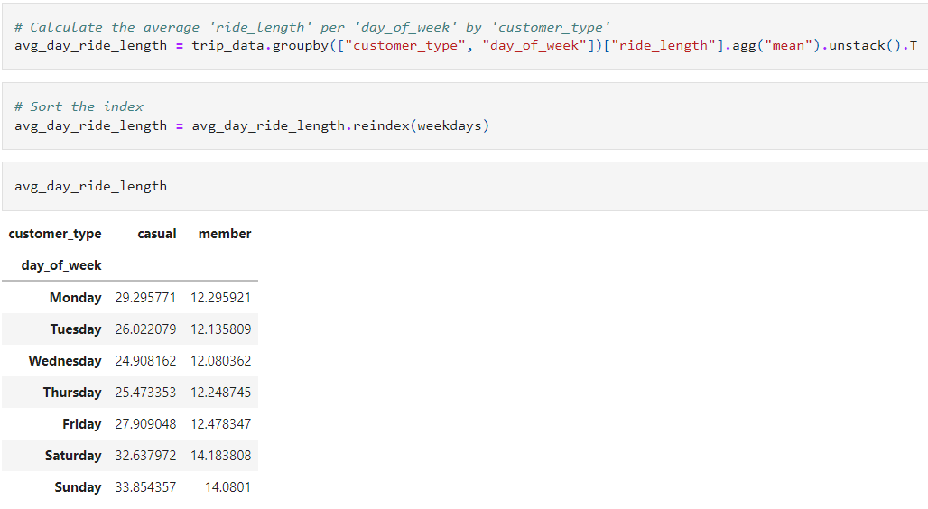
Average Rides Length per Day
Notes:
Code use to calculate the average ride length per day of week by customer type.

Slide 27
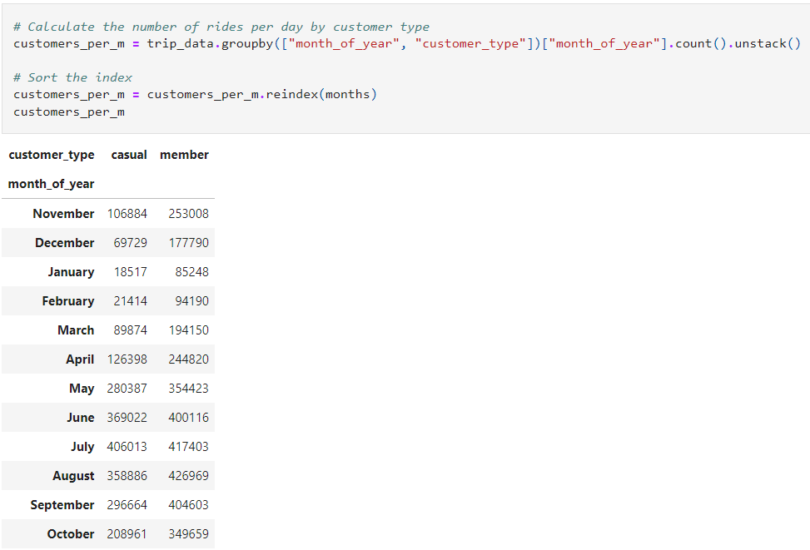
Rides per Month by Customer Type
Notes:
Code use to calculate the number of rides per month occurred by customer type.

Slide 28
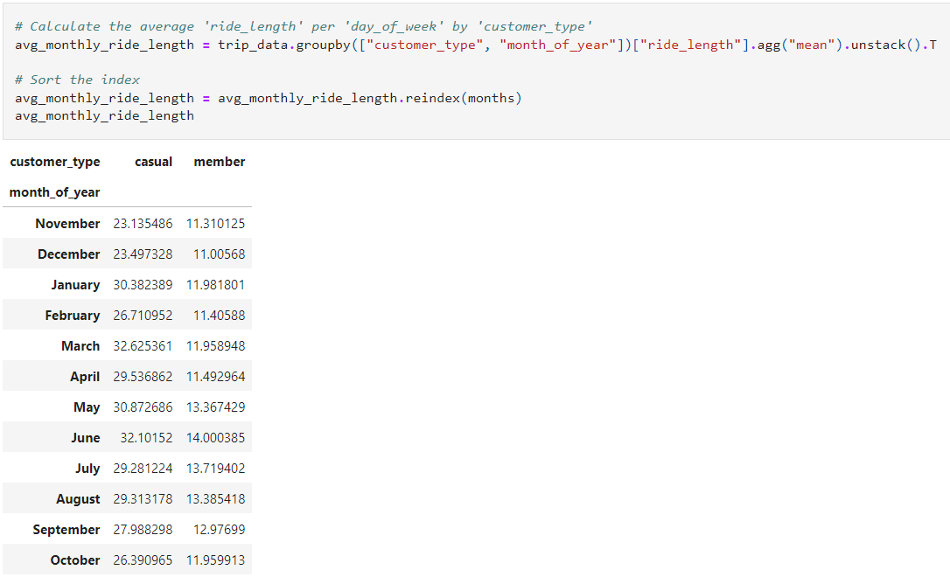
Average Rides Length per Month
Notes:
Code use to calculate the average ride length per month by customer type.

